Slide 1
1 Planed
Finish studying the code you wrote to parse the PE File.
I planed to finish Project1,2,3.
Start to study the assemble language.
4

Slide 2
1 Results
Results 1
just finish the Project1 and do not follow the standard you provided to write the code.
finish learning the whole code you provide in blog.
4

Slide 3
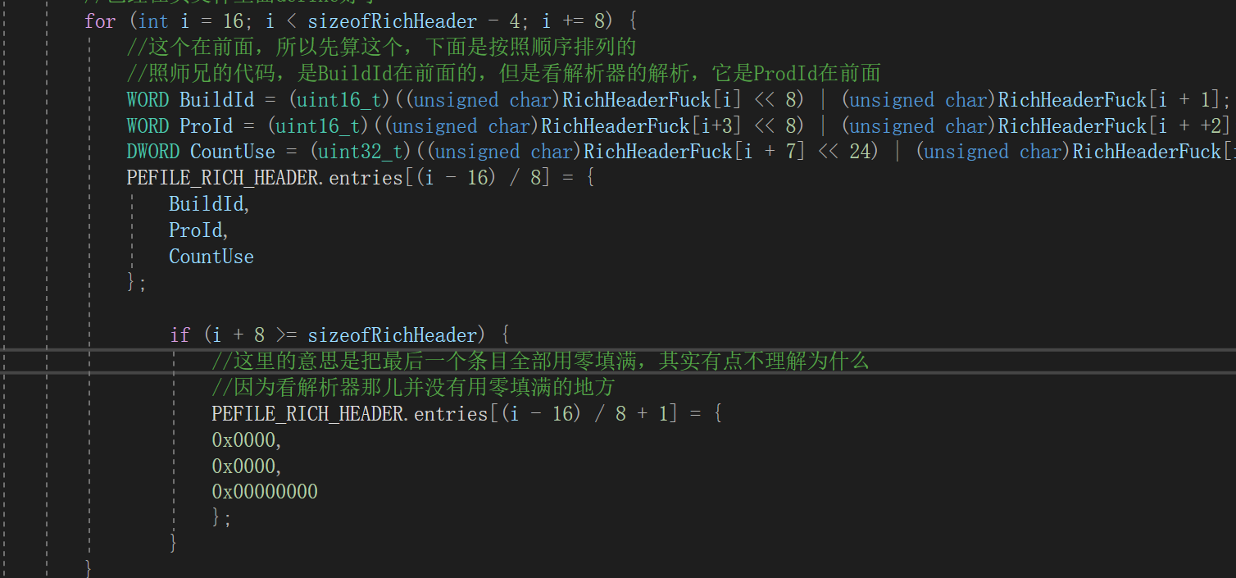
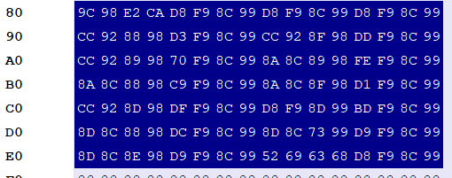
1 Challenges and Solutions
Challenges and solutions 1
Why the last entry is zero-padded?While the Rich Header is parsed,i don’t find the zero-padded part.
4

Slide 4
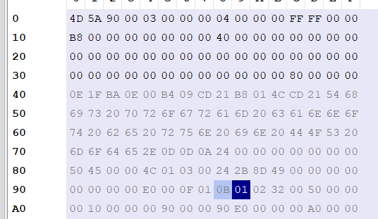
2 Challenges and Solutions
Please look at the screenshot.The DosHeader.e_lfanew plus sizeof(WORD) and sizeof(IMAGE_FILE_HEADER) the pointer of the file will point at the 0x0B,then the ‘TheTypeOfFile’ will be the 0x10B0.Otherwise,if i use ‘sizeof(DWORD)’ the ‘TheTypeOfFile’ will be the 0x2320.
I print the File_Header one WORD by one WORD and find 0x4550,0x0000 the two values are not included in the IMAGE_FILE_HEADER so the offset needs to plus sizeof(DWORD).
Challenges and solutions 2
4

Slide 5
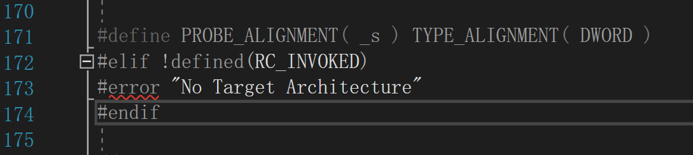
3 Challenges and Solutions
Challenges and solutions 3
Maybe i have not installed the wondows SDK.I still don’t known the reason of it and how to solve it.I don’t import the ‘winnt.h’ while i just define structures of the headers in ‘winntdef64’,but VS throws a error ‘No Target...’.Why?
4

Slide 6
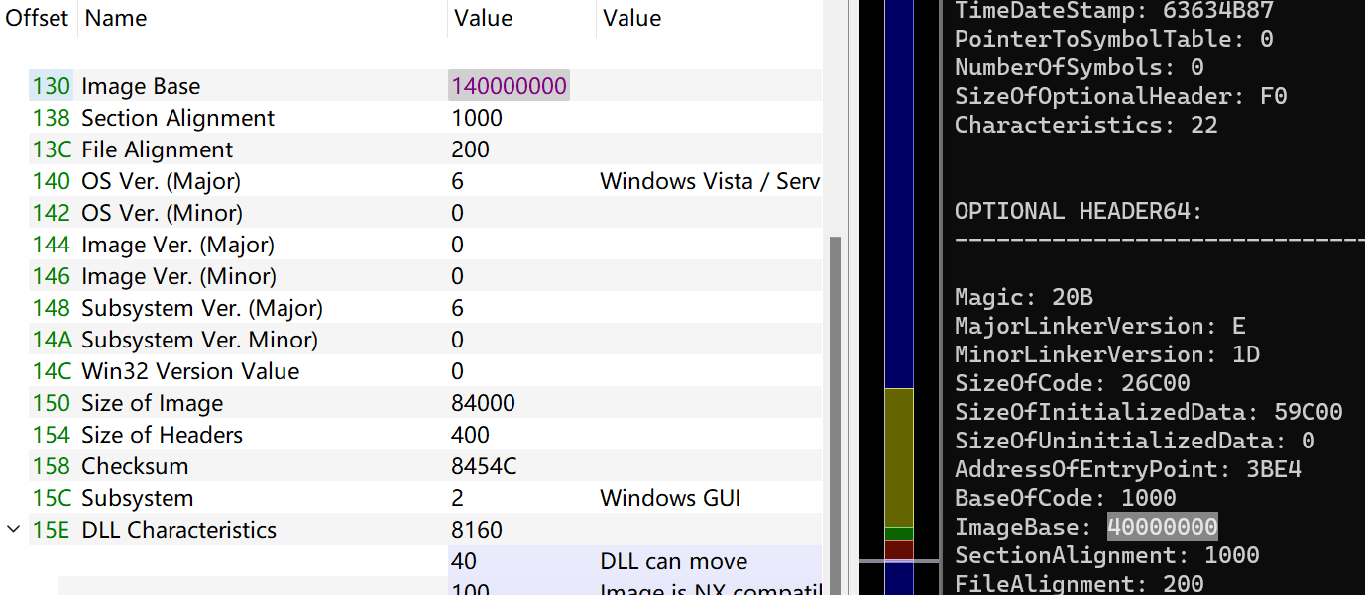
4 Challenges and Solutions
Challenges and solutions 4
Please look at the screenshot,why the ‘Image Base’ is different but other values are the same.
I guess that the type of the parameter doesn’t match,right?
I find that you also ‘printf(“%X”)’ ,why? The Parameter types do not match will cause data accuracy loss?
4

Slide 7
5 Challenges and Solutions
Challenges and solutions 5
Today i meet a problem,.The following is my code that parses the PE Headers ,i do not follow your standard to write the code because i now am not able to use the GitHub skillfully.
The problem is that it can parse the eclipse.exe correctly,but can’t parse the 302746537.exe you provide.
OKOK,after i write the question 1 minute,i realize that i have copied the wreong path,i solve the problem.
https://github.com/QXinHan/BugOwner/tree/ParsePEHds
4

Slide 8
1 Plan
plan 1
I want to start to study the assemble language.
After i start studying the assemble language i will make the plan in details.
4

